Slide 1
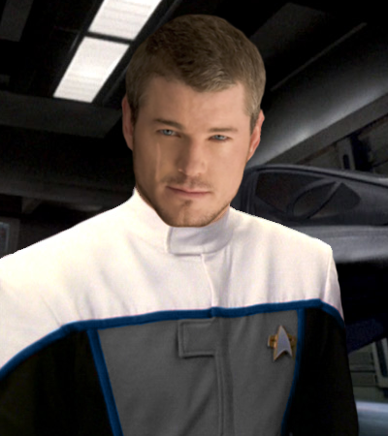
Roleplaying in an Air Group: CAGs and Fighter Jocks
How to write and play Starfleet Aerospace personnel

Slide 2
Who is Steve Harmon?
I have been into role-playing of various kinds since the early 70's. Am an avid D&D player. I am an actor, both on stage and for audiobooks, and am very good at improv, and playing off of other people. I am also a writer, with strengths in character development, action scenes, and plot development, and have recently made my first professional story sale under the name S. M. Harmon. I have played in various fleets over the years, including Obsidian and Theta Fleets. I have Been a DM, A ship’s Captain, Fleet Marine Commander, Pilot, and CAG. In real life, I served a tour in the United States Marine Corps in Operation Desert Storm. Currently, I work in IT, and have been in the computer industry since before Windows 95 was even a twinkle in Bill Gates’ eye.

Slide 3
What is a fighter group?
A Group is a unit of the Starfleet Starfighter Corps made up of three different types of squadrons and totaling thirty-six starfighters. At least one squadron of any group will be a Starfighter squadron. The second squadron will be either a Reconnaissance squadron or an Interceptor squadron, and the third will be either a Bomber squadron or an Attack squadron.
In addition to the support craft and personnel assigned to each squadrons, a Group will also have a fourth Warhammer-class SWACS runabout and a Raptor-class COD craft, as well as approximately eighty additional support personnel. Some Groups are also assigned a Viper-class Attack Craft when the Group Leader is not the seniormost Squadron Leader.
The typical group is commanded by a Commander.

Slide 4
Why is the Air Group Commander referred to as cag?
The Commander, Air Group, or CAG position is a hold over from the United States Navy of 1940s Earth. This officer, who filled a Captain's Billet, was in charge of an Aircraft Carrier's entire Air Group ranging anywhere from a hand full to a hundred aircraft. The CAG was the most senior member of the airwing, and was expected to lead all major strike operations. in the 1970s The terminology was changed and the Carrier Air Group became known as a Carrier Air Wing or CVW,but the position of CAG was retained. Shortly after, the position of CAG became co-equal to the Carrier's Commanding Officer, Both of whom reporting directly to the Flag Officer in command of the entire Carrier Battle Group.

Slide 5
Why is the Air Group Commander referred to as cag?
With the advent of warp powered spacecraft in the late 21st and early 22nd Centuries, the need for a space bourne fighter craft which could accompany a large fleet was recognized, and the Yorktown-class carrier, with it's Minotaur Fighter, was fielded in the latter half of the Earth-Romulan War although, each Carrier only carried five of the fighters and an additional compliment of Shuttlepods, Earth Starfleet assigned each an officer equivalent to a department head, known as the Carrier Space Wing Commander, who would be in charge of the Space Wing, the position was informally referred to as the CAG, and the name stuck.

Slide 6
Why is the Air Group Commander referred to as cag?
By the 2380s the CAG's position, now organized under the banner of Starfleet Fighter Command had remained essentially unchanged, but in 2381 Starfleet Command elevated the position to replace the Executive Officer on a Carrier, essentially giving them an elevated status over the other department heads, and a closer working relationship with the CO.

Slide 7
What are the responsibilities of the CAG?
The Group Commander (CAG) is in charge of all things related to his Group's Tactical personnel and their fighters, generally a responsibility of all Flight Wings assigned to a base or starship. The CAG is responsible for all the personnel assigned to the Group on the ship/facility, and ensuring that combat readiness, mission load outs, maintenance checks, and repairs are done so all fighters are mission ready. The CAG reports to the Commanding Officer and is a member of the Senior Staff.

Slide 8
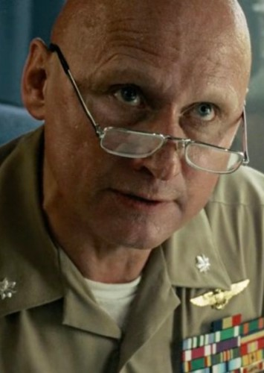
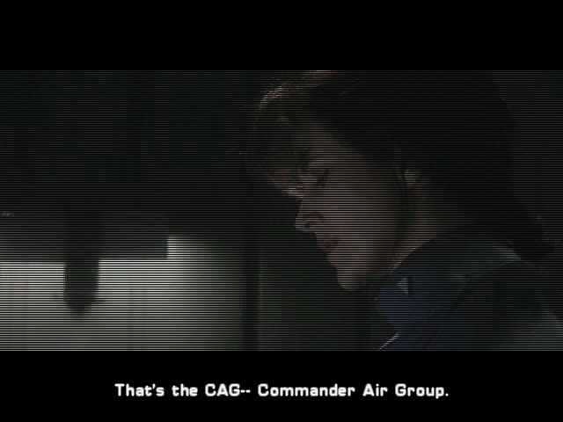
Examples of CAG in Hollywood
I have two main sources of CAG that I pattern my Air Group Commanders after.
Top Gun: Commander Tom “Stinger Jardin”
Wing Commander Prophecy: Commander Drake

Slide 9
Video Clips
Granted, these are stereotypes and tropes, but we are, after all, writing fiction.

Slide 10
CAG needs to be played as a senior officer, and usually answers directly to the Captain
Most commanders are disciplined, no-nonsense officers with excellent organizational skills who know the pilots under their command. They know their strengths, weaknesses, and personalities. They also know how to get the best out of their pilots.
CAG can still fly with their Air group, but only under extraordinary situations. They are still qualified pilots, and also oversee the continued training of the pilots under their command.
Under no circumstances will the CAG ever countermand the orders of the Captain, even if they are of equivalent rank. The Captain must also have confidence in the CAG, and trust their judgement when it comes to Air Group operations and staffing.

Slide 11
Now let’s talk about pilots
A Starfleet Fighter pilot is defined by a certain amount of self-confidence and self-respect for their own skills in regards to their training. Some pilots might have been mice outside of the cockpit, but because of training or inner strength, they turn into formidable piloting machines once they get into their fighters. The ones that withered under battle pressure were weeded out early in Tactical CONN Academy, Starfleet’s version of “Top Gun”
There is also the great trust they have in their fellow pilots; a 'pack' mentality that kicks in. On duty - especially in combat situations - more than half of their fighting ability comes from the support provided by their Squadron. Off duty, there was a certain appreciation for the essence of life itself; a certain flare of enjoying life with more color and enthusiasm than their fellow Starfleet officers might display. Day in and day out they go out there and willingly throw themselves in front of bullets.
Fighter pilots court death and face losing friends every day, so there is a constant state of heightened adrenaline, and thus a greater appreciation for life. Their pack mentality generates some off duty tendencies as well, like wearing matching flight jackets, necklaces, or hoodies that bolster their team spirit.

Slide 12
Common pilot Terminology
Combat Geometry
Angle Off - The difference between your heading and the ship you wished to attack in degrees
Angle off Tail (AoT) - The angle between your flight path and the flight path of the ship you wished to attack
Aspect Angle - The number of degrees between the tail of the other ship and your ship
Range - The distance between your ship and the target ship

Slide 13
Common pilot Terminology
Attack Terms
Closure Rate - The speed of your ship relative to the speed of the target ship.
Cone of vulnerability - The area of space that put you in range of your enemy's weapons. The only cone worse than the "Cone of Silence".
Corner speed - The speed at which a fighter/vessel could achieve its best turn radius
Turn rate/ Turn radius - The number of degrees a fighter/vessel could pivot per second.
Weapons Envelope - The area in which a weapon was effective. It was specific to the weapon and included maximum and minimum range.

Slide 14
Pilot Chatter
Bandit - Enemy vessel
Bent - Sensors inoperative
Bogey - Unknown vessel
Buddy spike - Being tracked/targeted by friendly forces. Look out for friendly fire
Bug out - Disengage
Clean - No contacts
Clear - No enemy threat to you
Contact - Located target
Mud spike - Being targeted by ground radar or planetary defense systems
No Joy - No contact of target. Opposite of "tally"
Target - That thing you are looking for or want to get rid of
Tally - Opposite of "no joy". Target, bandit, or bogey has been sighted

Slide 15
Examples of fighter pilots in Hollywood
“Top Gun”
Wing Commander: Prophecy”

Slide 16
Video Clips
Granted, these are stereotypes and tropes, but we are, after all, writing fiction.

Slide 17
Excerpts from Fleet Archives
Hearing the Red Alert, Marcus bolted out of his rack, and threw on his uniform. He was out of his quarters and running full steam ahead for the hangar bay. He tapped his comm badge. =A= Operations, this is Second Lieutenant DeSalle commanding the Marine Fighter Wing! Request immediate Sit-Rep! Transfer data immediately to all Fighter Craft! Will brief during launch! DeSalle Out! =A= He burst through the locker-room doors, touched his thumb to his locker, and threw open the door. Grabbing his helmet and flight suit, he changed in about one minute, and was bolting towards his bird.
He saw his Wing all rushing to their fighters, scrambling to get into their cockpits. As he started up his engines, he booted up the onboard computer. Going through a pre-flight check, he requested the Sit-Rep loaded by Ops. The data scrolled onto his screen, being verbally repeated by the computer at the same time.
"Red Alert, Red Alert. All personnel, report to battle stations! Sensors indicate a large group of hostile spacecraft of small to medium configuration approaching at Warp speed. No identifiable IFF code. No response to hails. The craft are within the defensive perimeter, at a range of 500,000 Km and closing rapidly. Charging planetary defense phaser cannon, and scrambling all fighters. Intercept at two-two-zero mark ten! Identify hostiles and fire at will."
Marcus felt the familiar adrenaline rush as he keyed his comm system through his helmet. "OK, Pilots, you know as much as I do, now. Lauch and form up as soon as you clear the atmosphere! I want either visual or sensor ID on the bogeys! If they're hostile, break and attack! I say again, Break and attack!"
He punched the impulse afterburners on his sleek craft, and bulleted heavenward, intent on leading his wing, and getting them all home in one piece.

Slide 18
Conclusion
The main thing when playing aviators is that they are just as different from each other as anyone else in the fleet. That being said, they are highly skilled officers, trained to be the best pilots in the fleet. They are deadly in the cockpit, and have a right to be proud, and even a little arrogant. Their Esprit de Corps is legendary, and they are some of the closest-knit groups in the fleet. They live life on the edge, knowing that every time they fly could be their last. They form strong bonds quickly, but Heaven help you if you betray their trust, for you will have made an enemy of the entire squadron, not just the pilot you wronged. If you want to play a pilot, watch some aviation movies and TV series, such as Baa Baa Black Sheep, Top Gun, Play video games like the Wing Commander Series, and watch documentaries on legendary military aviators like Eddie Richenbacher and Baron Von Richtoven, or Greg “Pappy” Boyington.

